Slide 1
Safari pub quiz

Slide 2
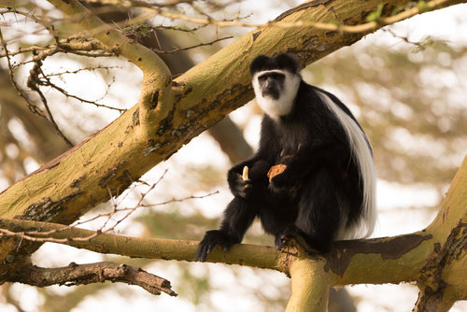
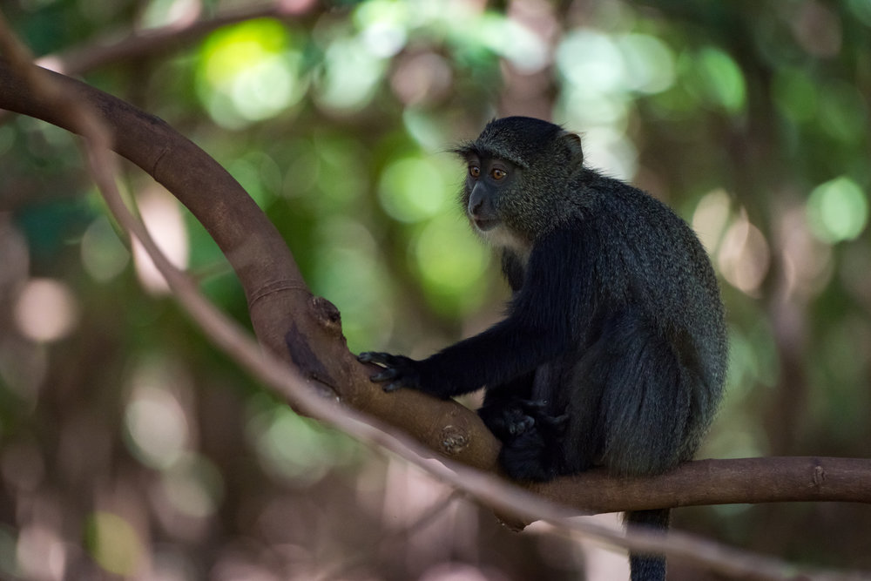
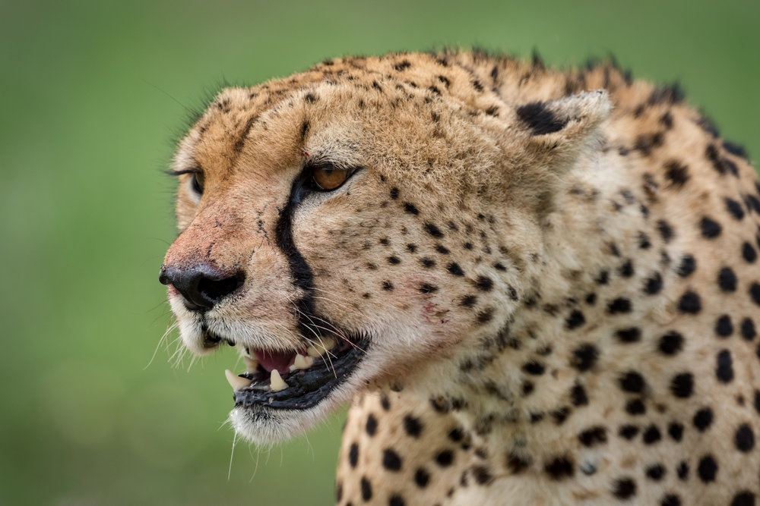
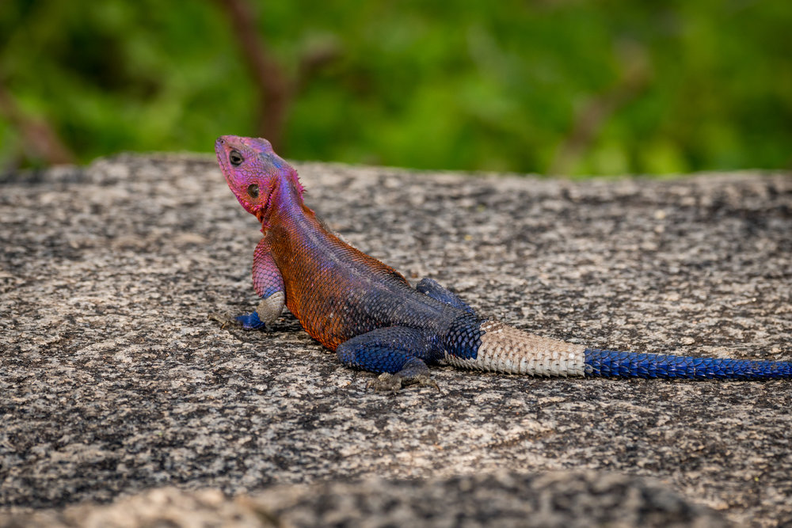
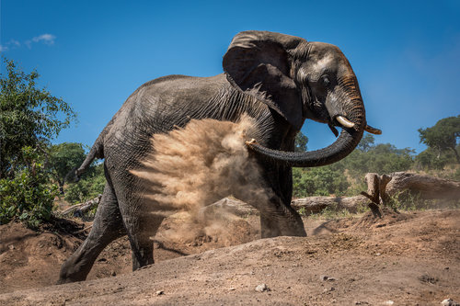
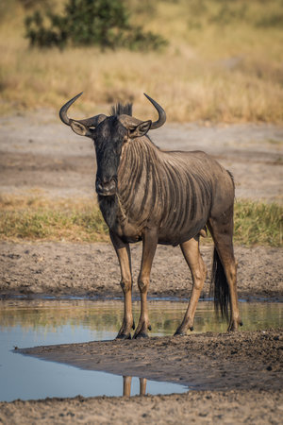
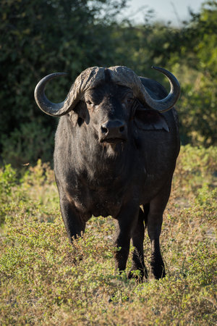
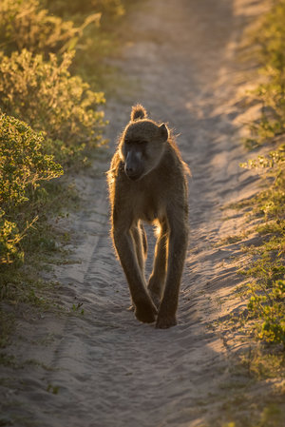
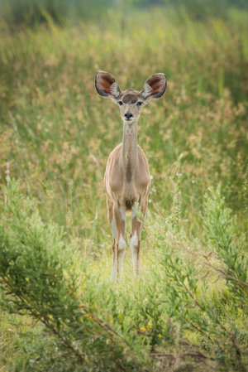
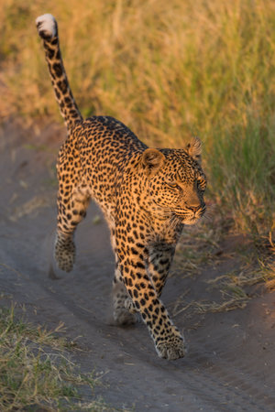
Round 1 – Animal recognition
A.
B.
C.
D.
E.
F.
G.
H.
I.
J.
Notes:
Colobus monkey
Blue monkey
Cheetah
Agama lizard
African elephant
Blue wildebeest
African buffalo
Chacma baboon
Greater kudu
Leopard

Slide 3
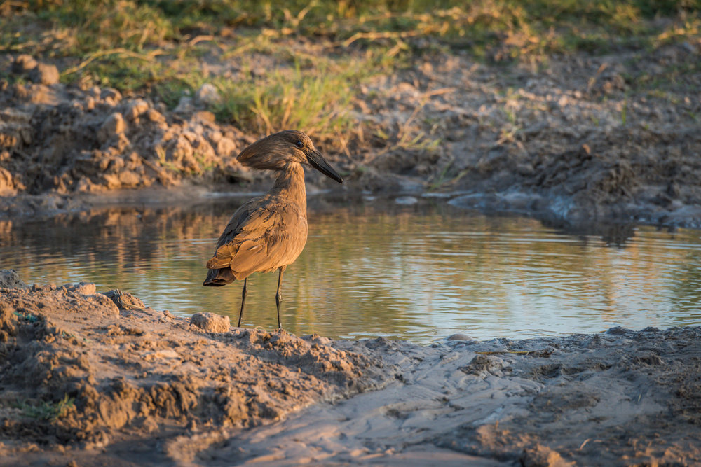
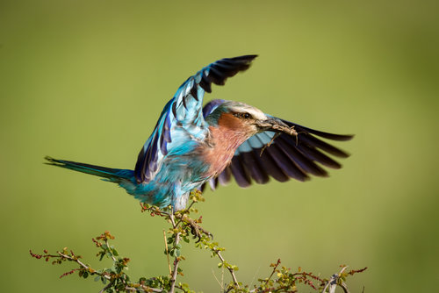
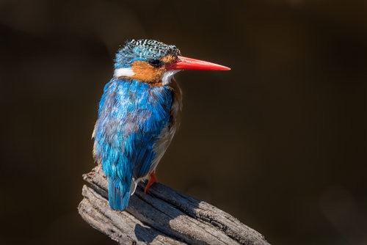
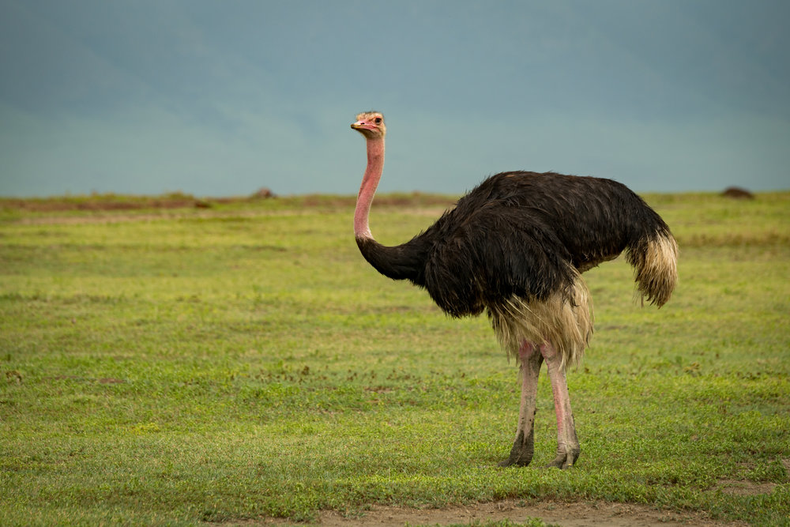
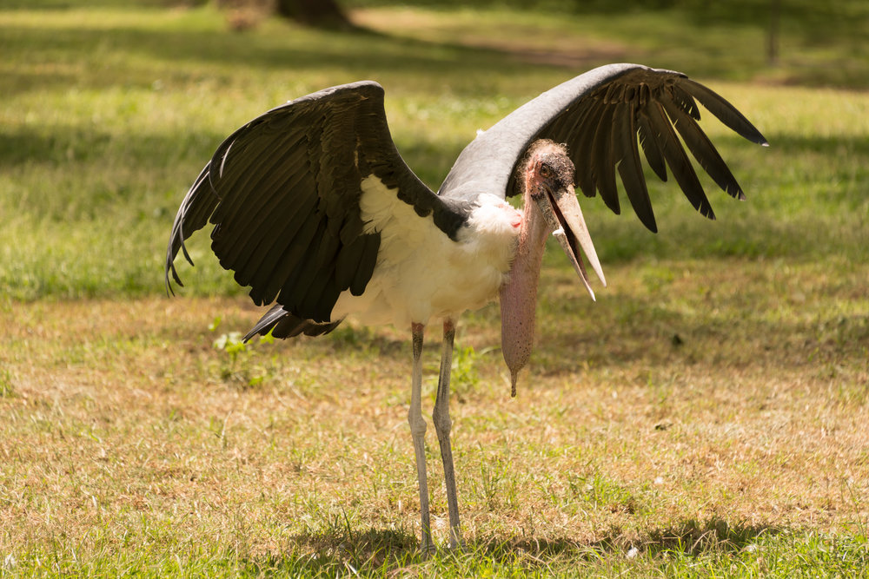
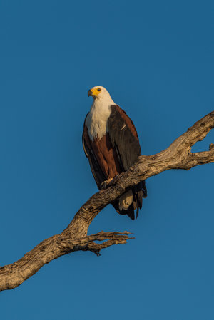
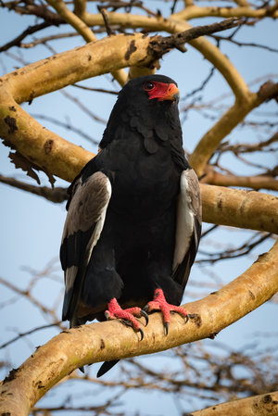
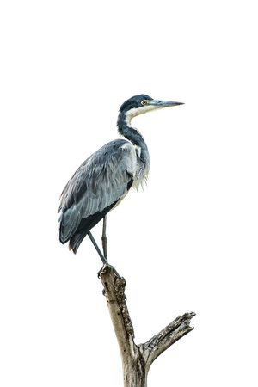
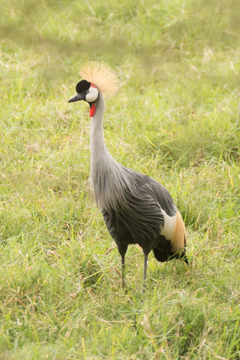
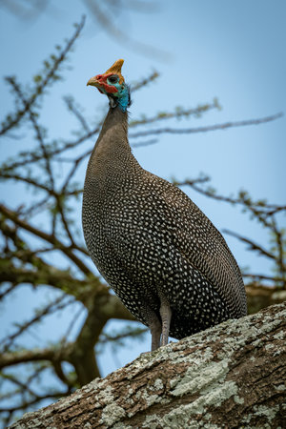
Round 2 – Bird recognition
A.
B.
C.
D.
E.
F.
G.
H.
I.
J.
Notes:
Hammerkop
Lilac-breasted roller
Malachite kingfisher
Ostrich
Marabou stork
African fish eagle
Bateleur eagle
Black-headed heron
Grey crowned crane
Helmeted guineafowl

Slide 4
Round 3 – Animal groups
What is the collective noun for these animals?
Lion (group, herd or pride)
Elephant (herd, group or caravan)
Zebra (dazzle, stripe or stare)
Stationary giraffe (stand, stretch or tower)
Moving giraffe (gallop, trip or journey)
Mongoose (bunch, business or crew)
Hyena (laugh, cackle or grin)
Gorilla (whoop, gang or set)
Leopard (jump, leap or spot)
Buffalo (glare, obstinacy or stubbornness)
Notes:
Pride
Herd
Dazzle
Tower
Journey
Business (or colony)
Cackle
Whoop
Leap
Obstinacy

Slide 5
Round 4 – Bird groups
What is the collective noun for these birds?
Flamingo (flamboyance, extravagance or fulmination)
Vulture (funeral, wake or coven)
Ostrich (conceit, pride or vanity)
Goose (gander, huddle or gaggle)
Guinea fowl (confusion, miscellany or chaos)
Eagle (convocation, synod or gathering)
Heron (bush, balance or hedge)
Owl (parliament, congress or flock)
Pelican (cluster, pod or catch)
Oxpecker (throw, fling or chuck)
Notes:
Flamboyance
Wake
Pride
Gaggle
Confusion
Convocation
Hedge
Parliament
Pod
Fling

Slide 6
Round 5 – Lifespans
What is the maximum lifespan of these animals (±10 years)?
Buffalo
Chimpanzee
Elephant
Giraffe
Hippopotamus
Lion
Rhinoceros
Zebra
Ostrich
Crocodile
Notes:
45
50
50
28
41
35
40
30
50
13.5

Slide 7
Round 6 – Pregnancy
How many months is the gestation period for these animals?
Leopard
Lion
Elephant
Giraffe
Hippopotamus
Cheetah
Rhinoceros
Zebra
African buffalo
Baboon
Notes:
3 months
3 months
21-22 months
14 months
8 months
3 months
16 months
13 months
11 months
6 months

Slide 8
Round 7 – Endangered species
Are these animals ‘least concern’, ‘near threatened’, ‘vulnerable’ or ‘critically endangered’?
Lion
Elephant
African buffalo
Leopard
White rhinoceros
Black rhinoceros
Cheetah
Plains zebra
Giraffe
Common warthog
Notes:
Vulnerable
Vulnerable
Least concern
Vulnerable
Near threatened
Critically endangered
Vulnerable
Near threatened
Vulnerable
Least concern

Slide 9
Round 8 – True or false?
Elephants can get sunburnt
Elephants’ closest relatives are dugong and hyrax
Lions greet each other by rubbing their heads
African lions are only found in 20% of their historic range
Lions can sleep up to 20 hours a day
Leopards are the most social felines on Earth
Leopards can’t swim
Rhinos have three hoofed toes per foot
Rhino horns are made of keratin
Buffalo kill 200 people a year in Africa
Notes:
T
T
T
F (only 8%)
T
F
F
T
T
T

Slide 10
Round 9 – Latin cat names
Match the following common names with their Latin equivalents:
African golden cat
African wildcat
Black-footed cat
Caracal
Cheetah
Jungle cat
Leopard
Lion
Sand cat
Serval
Acinonyx jubatus
Caracal aurata
Caracal caracal
Felis chaus
Felis lybica
Felis margarita
Felis nigripes
Leptailurus serval
Panthera pardus
Panthera leo
Notes:
2
5
7
3
1
4
9
10
6
8

Slide 11
Round 10 – Various
Which animals are in the Big Five?
Which animals are in the Ugly Five?
What are the world’s five biggest cats in order?
How many litres of water can an elephant hold in its trunk?
How many people do hippos kill every year?
Where does the Rift Valley start and finish?
On which African mountain is Point Lenana?
Who wrote The Snows of Kilimanjaro?
Who played Joy Adamson in Born Free?
Which book starts with the line “I had a farm in Africa…”?
Notes:
Lion, leopard, buffalo, elephant, rhino
Wildebeest, warthog, spotted hyena, lappet-faced vulture, marabou stork
Tiger, lion, jaguar, cougar, leopard
4-10 litres
500-5,000 people
Lebanon’s Beqaa Valley to Mozambique
Mount Kenya
Ernest Hemingway
Virginia McKenna
Out of Africa

