Slide 1
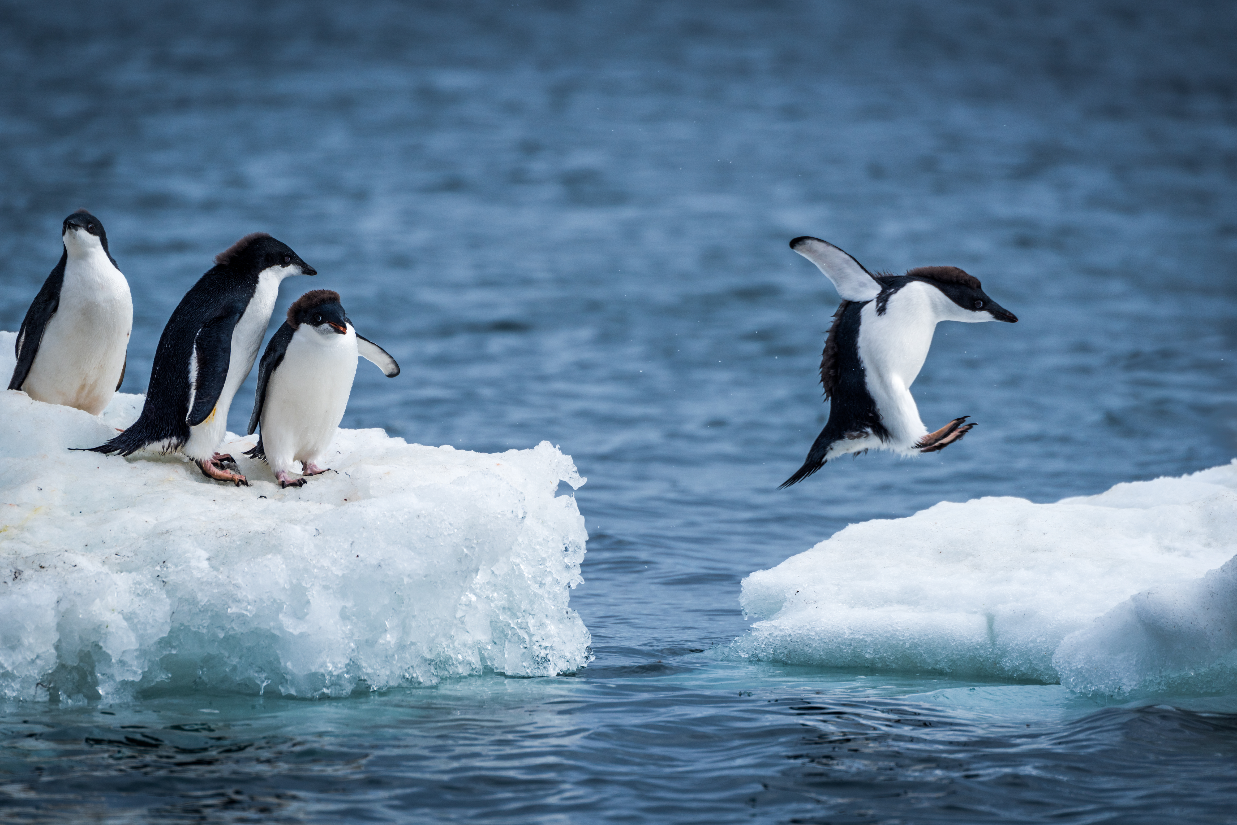
Making money from photography

Slide 2
My own career
My first camera
My mother’s advice
Thirty years later…
  Safari invitation
  My second camera
  Climbing Mount Kenya
  My third camera
  Travelling the world
  Microstock sales, exhibitions, talks, competitions etc

Slide 3
What do I need to do first?
Buy a camera
Buy a laptop
Subscribe to Lightroom
Start taking pictures
Start marketing your work
  Website
  Business cards
  Social media (Facebook, Instagram, Twitter etc)

Slide 4
How can I make money?
Revenue v profit
Microstock
  Getty Images
  Shutterstock
  Adobe etc
Stock agencies
  Design Pics etc
Competitions
Exhibitions
Photo shoots
Lessons
Talks
Photography trips

